Slide 1




KRAF THINK 2025 HACKATHON
Empowering innovation, fostering collaboration, and transforming ideas into reality – join the Kraf Think 2025 Hackathon revolution!
Team Name : Tech Titans
Team Leader Name : Khelendra Rauniyar
Team Members Name :Rahul Ranjan, Rohan Sah

Slide 2

Table of contents
01
05
06
02
03
07
Cover Slide
Technology Stack
Problem Statement
Features & Challenges
Solution Overview
Future Scope
Market Scope
08
Conclusion

Slide 3

Cover Letter
AI-powered Expense Tracking for Students
Tech Titans (Khelendra Rauniyar, Rahul Ranjan, Rohan Sah
Hackathon Name (Kraf Think 2025)
Date & Submission ID (2025-02-23)

Slide 4
Problem Statement
Managing personal finances can be challenging, especially for students and young professionals who struggle with tracking expenses, budgeting, and overspending. Traditional expense tracking methods are manual, time-consuming, and lack intelligent insights. This project aims to develop an AI-powered Expense Tracker that provides automated categorization, real-time insights, and predictive analytics to help users manage their finances efficiently.

Slide 5
Solution Overview
The AI-Powered Expense Tracker is a smart financial management app that helps users efficiently track, categorize, and analyse their expenses using real-time data and AI-driven insights.

Slide 6
Target Audience & Market Scope
Students, Working Professionals & Families.
Small & Medium Businesses (SMBs).
Financial Institutions & FinTech Startups.
Global Market Growth: $6.7B (2023) → $12.7B (2028).
AI-Powered Finance Apps: 74% of users prefer automated budgeting tools.

Slide 7
Technology Stack
Frontend: HTML, CSS, Bootstrap, Jinja2, JavaScript
Backend: Flask, Flask - SQLAlchemy, Flask-Login, Google Gemini AI
Database: SQLite, MySQL
Data Visualization: Chart.js or D3.js

Slide 8
Features
User Authentication – Secure login & session management.
Expense & Category Management – Add, edit, delete expenses.
Expense Tracking Dashboard – View total spending & history.
Data Visualization – Graphs for financial insights.
Responsive UI – Clean interface with Bootstrap.
Secure Database – Data stored using SQL Alchemy SQLite.
Personalized Chatbot
Expense Analytics

Slide 9
Challenges & Learnings
Authentication & Security → Used Flask-Login, bcrypt for encryption.
Database Performance → Optimized SQL Alchemy queries, added indexing.
Data Visualization → Integrated Chart.js, Matplotlib for reports.
User Input Validation → Used Flask-WTF for form validation.
Chatbot Integration → Integrated personalized Chatbot.
Finance Based Suggestion → Used Gemini AI for generating Suggestions.

Slide 10
Future Scope & Next Steps
We will implement OCR to receipt scanning.
We will integrate Payment Gateway for direct transaction tracking.
Crypto and Stock Investment Tracking.
Smart Budgeting and Alerting.
We will develop android and iOS-based app.

Slide 11
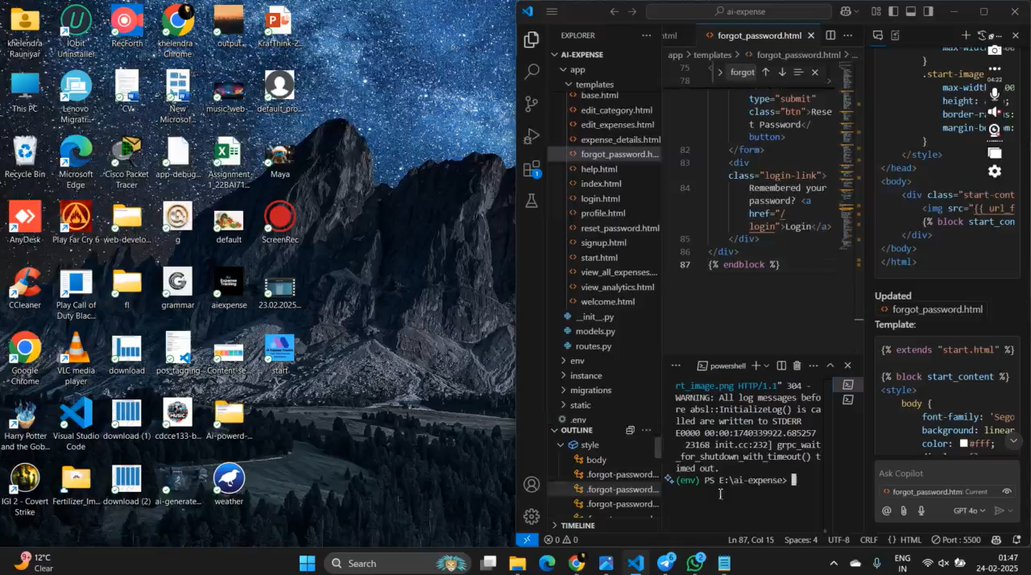
Project Demo

Slide 12
Conclusion & Thank You
"An AI-powered expense tracker that simplifies budgeting, categorizes expenses, and provides real-time insights for smarter financial decisions.“
Development , Backend & Database: Khelendra Rauniyar
UI/UX Design: Rahul Ranjan
Testing & Debugging: Rohan Sah
Contact details: 7739933172

